Slide 1
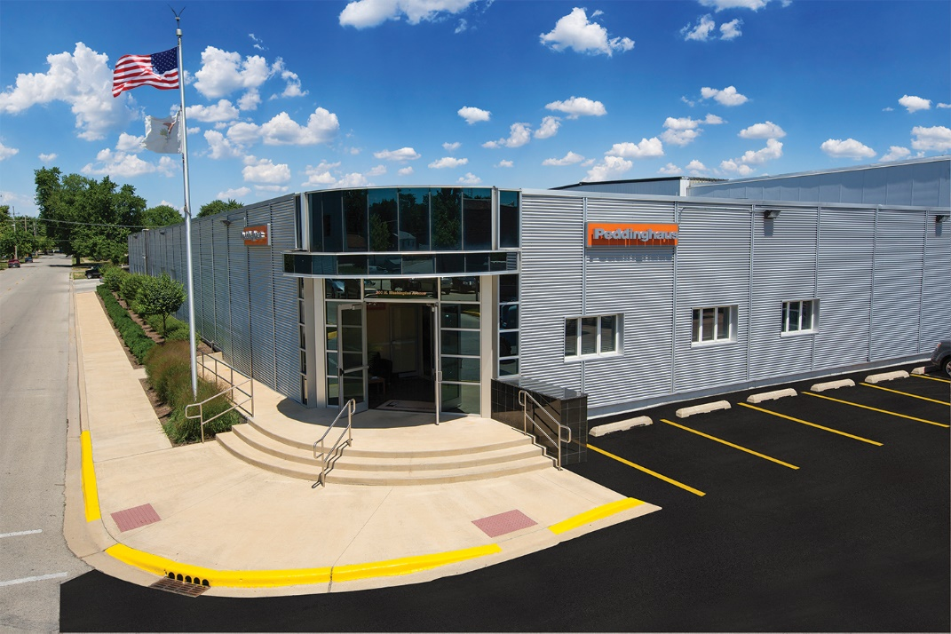
INTRODUCTION TO PEDDINGHAUS
June 2025 • Economic Alliance Meeting

Slide 2
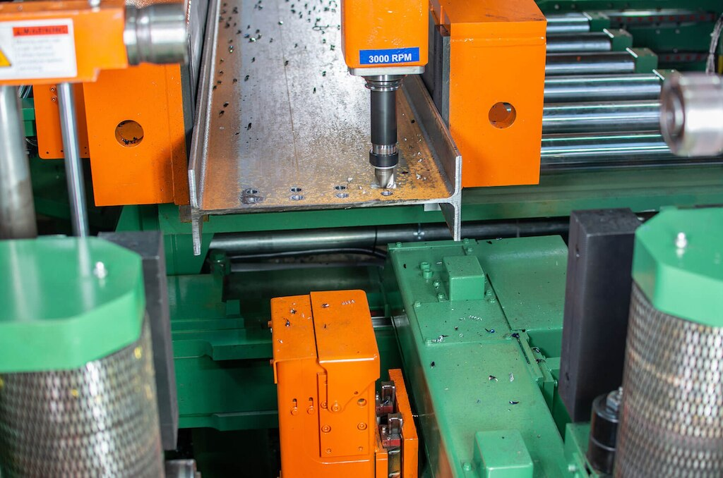
STRONGER THAN STEEL 🎥

Slide 3
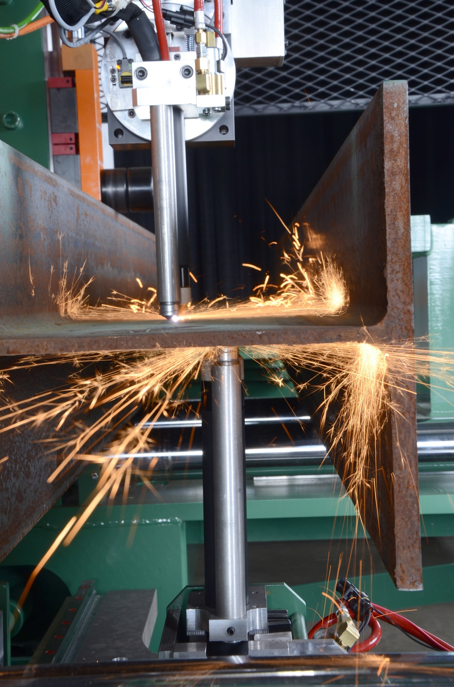
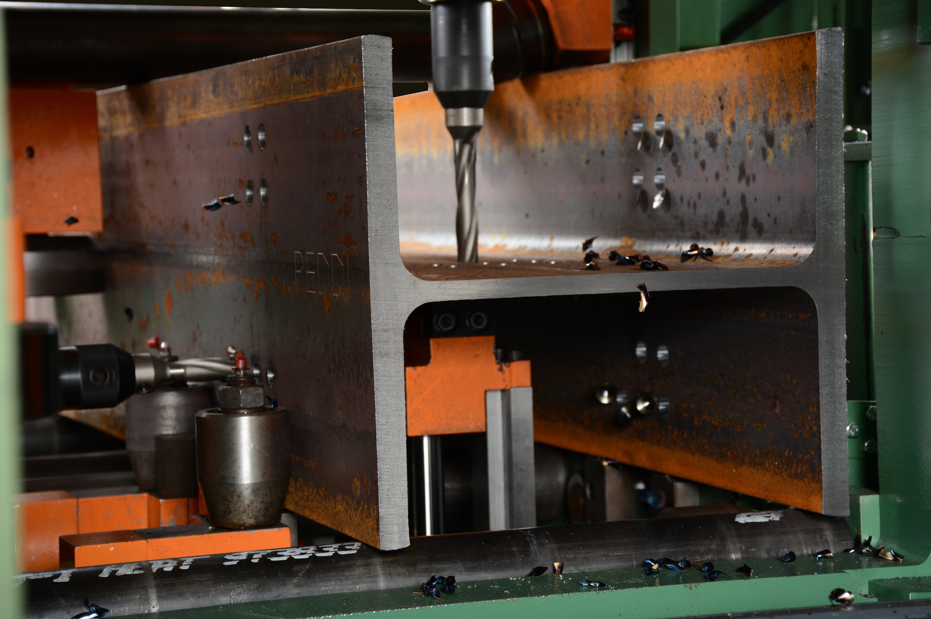
WHAT WE DO
Peddinghaus Corporation manufactures machines for structural steel fabricators

Slide 4
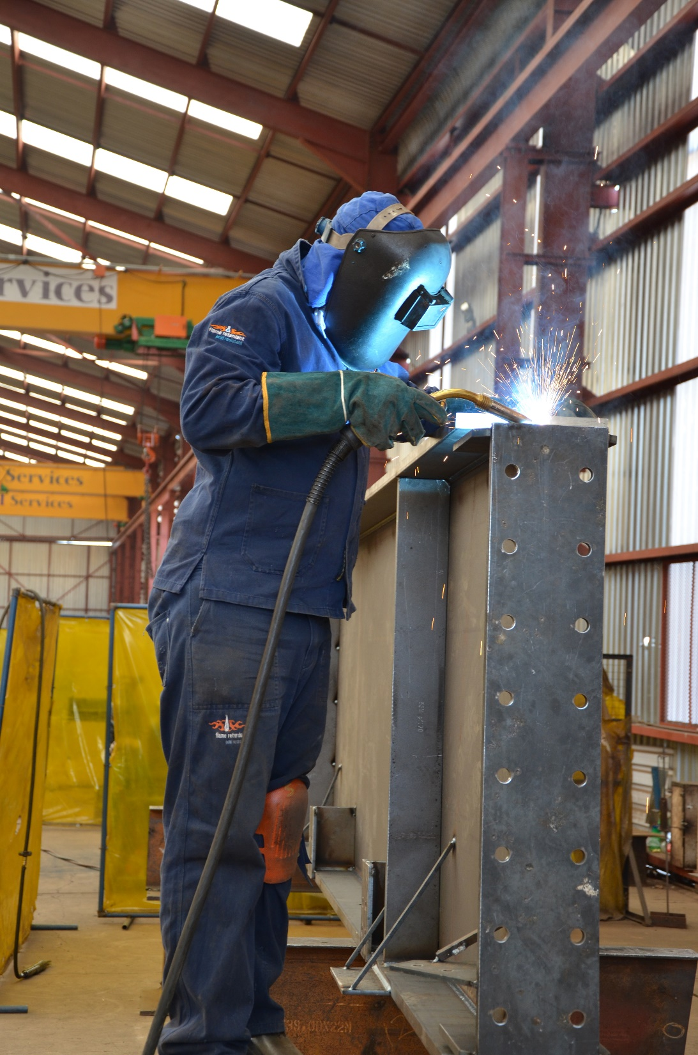
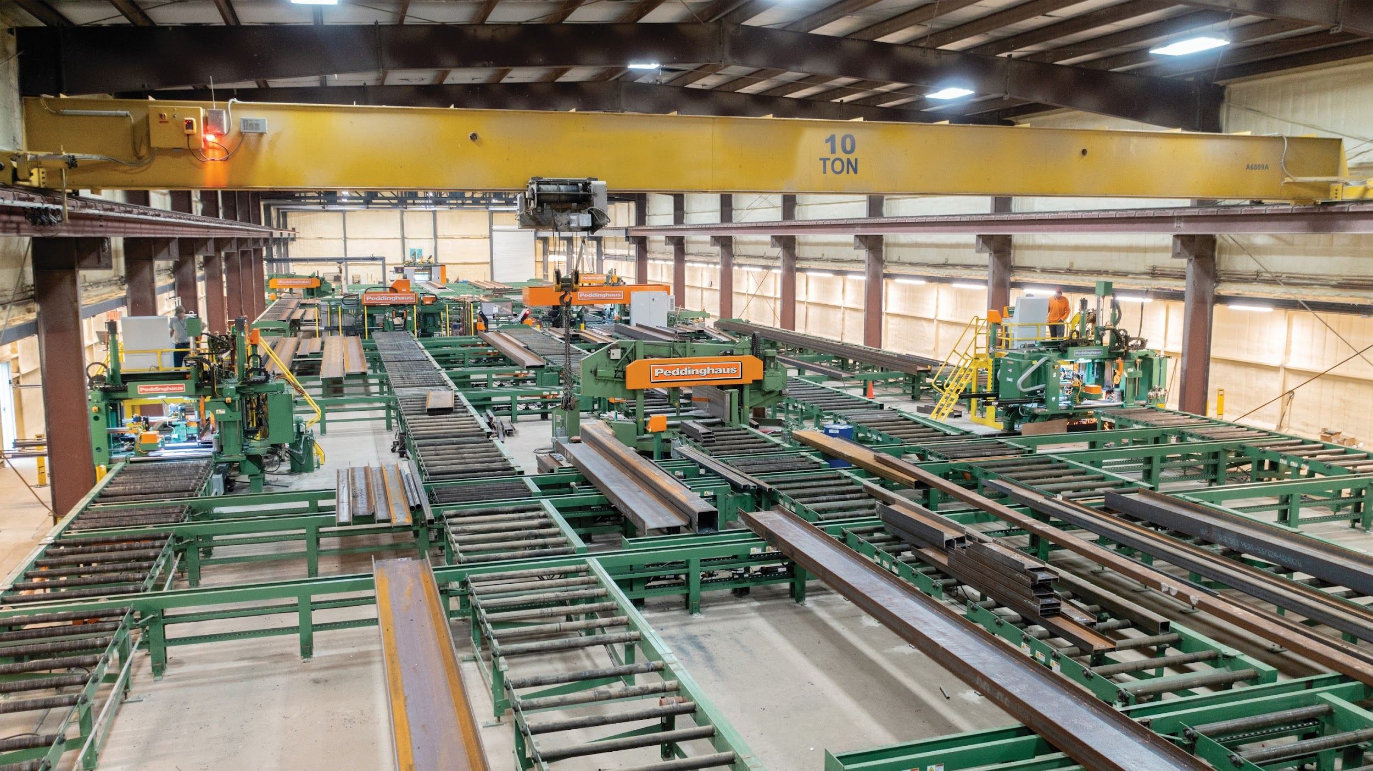
WHAT IS A FABRICATOR?

Slide 5
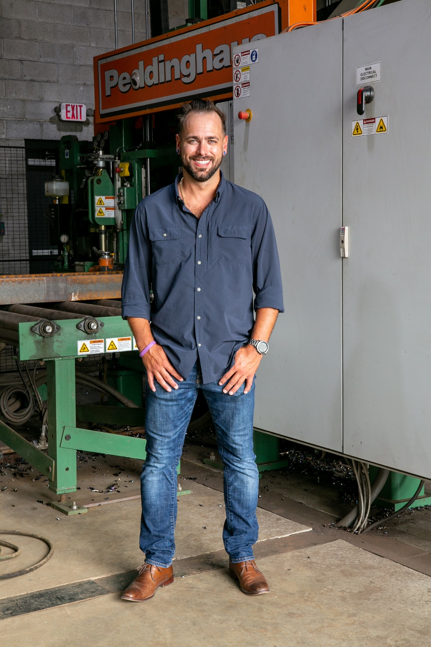
MEET JAKE THOMAS
CEO of Thomas Steel
Steel Fabricators
Bellevue, Ohio

Slide 6
BUILT IN THE USA!
Only Domestic Manufacturer of structural steel equipment
All components built in-house, not outsourced

Slide 7
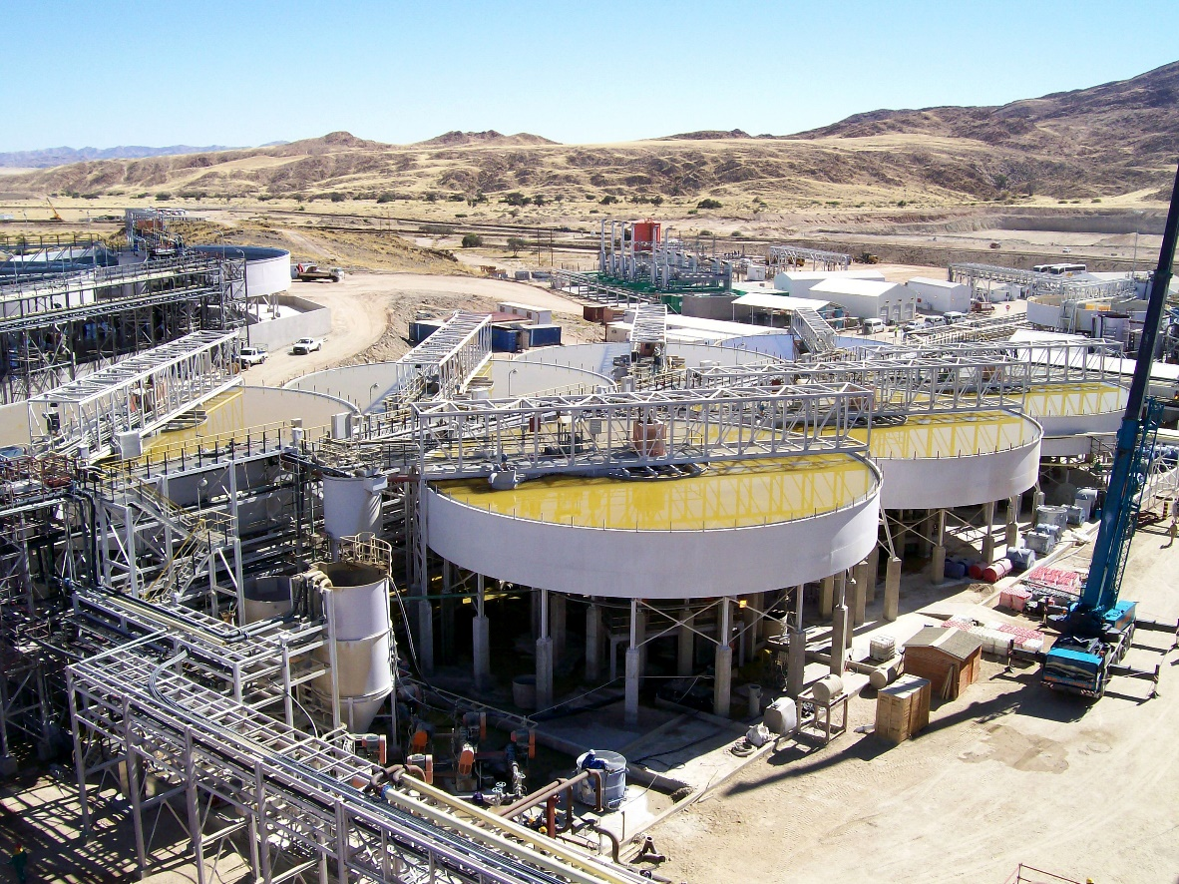
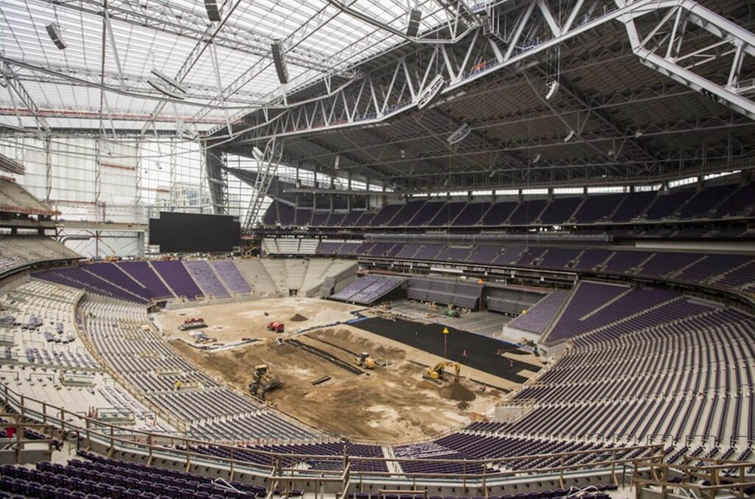
INDUSTRIES
SERVED
Stadiums
Mining
Powerplants
Bridges
Agriculture Equipment
Schools
Hospitals
Skyscrapers
Warehouses

Slide 8
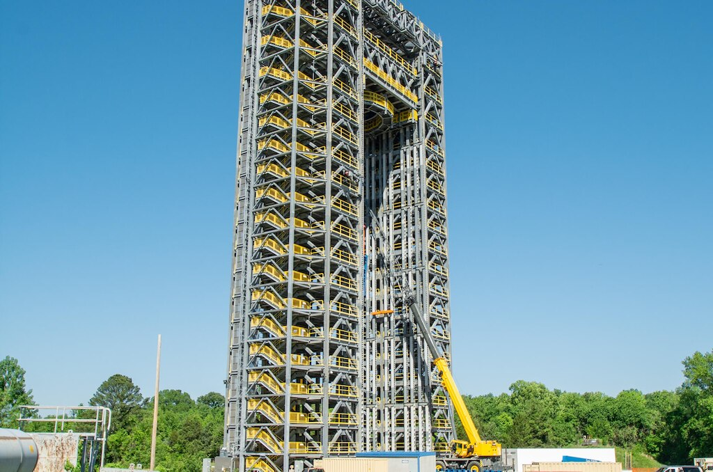
KENNEDY SPACE CENTER

Slide 9
VIKINGS STADIUM

Slide 10
THE SHARD - LONDON

Slide 11
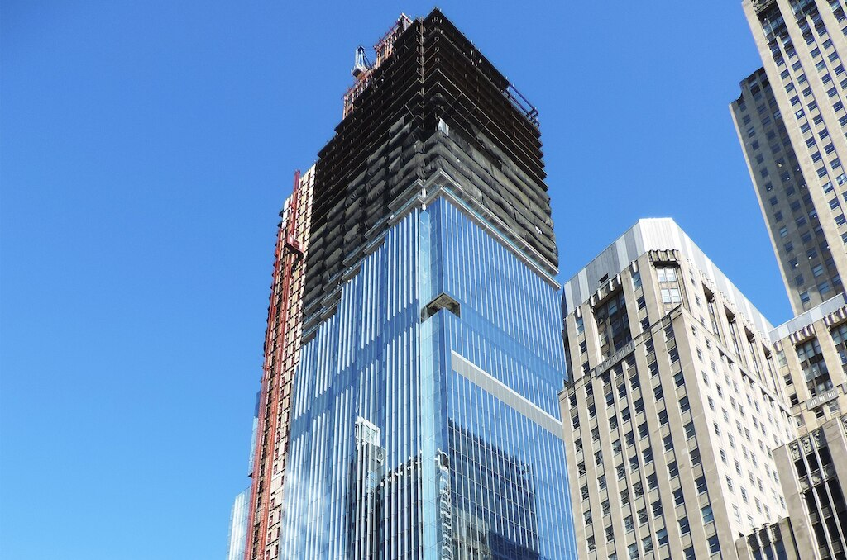
110 N WACKER

Slide 12
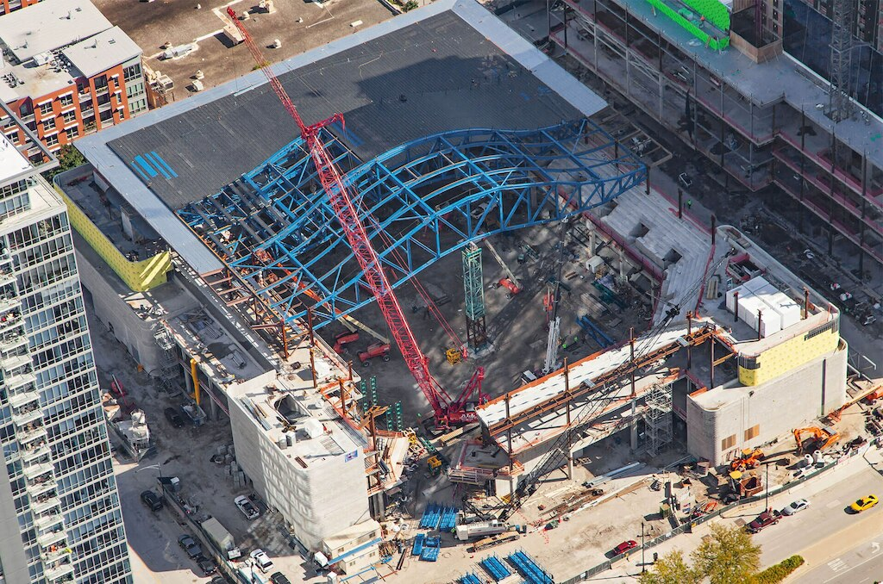
MCCORMICK PLACE

Slide 13
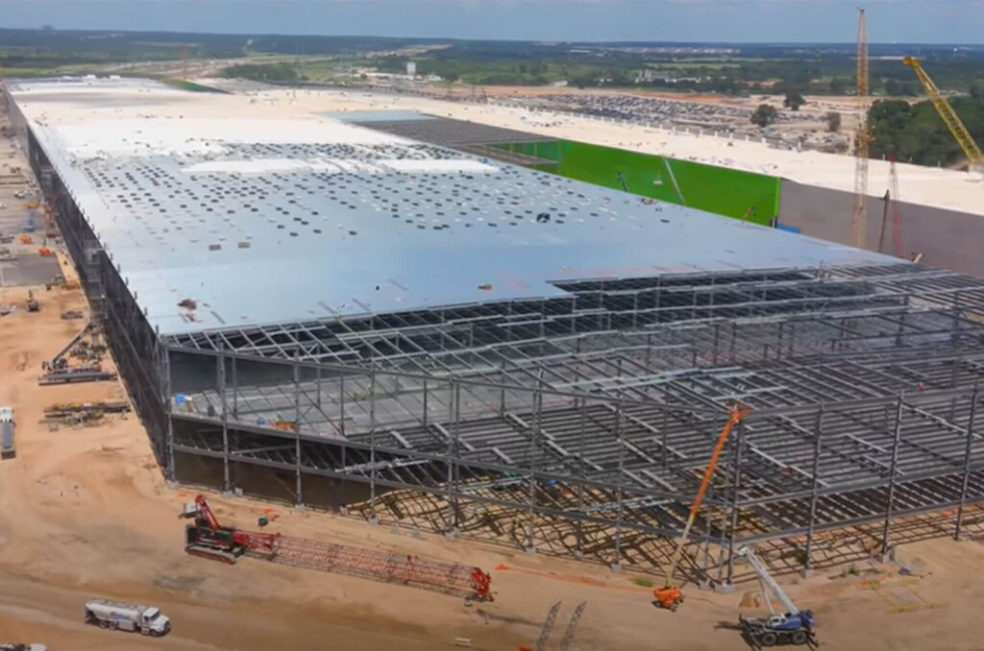
DATA CENTERS

Slide 14
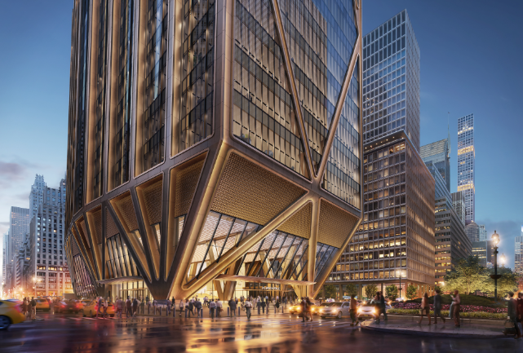
CHASE HEADQUARTERS

Slide 15
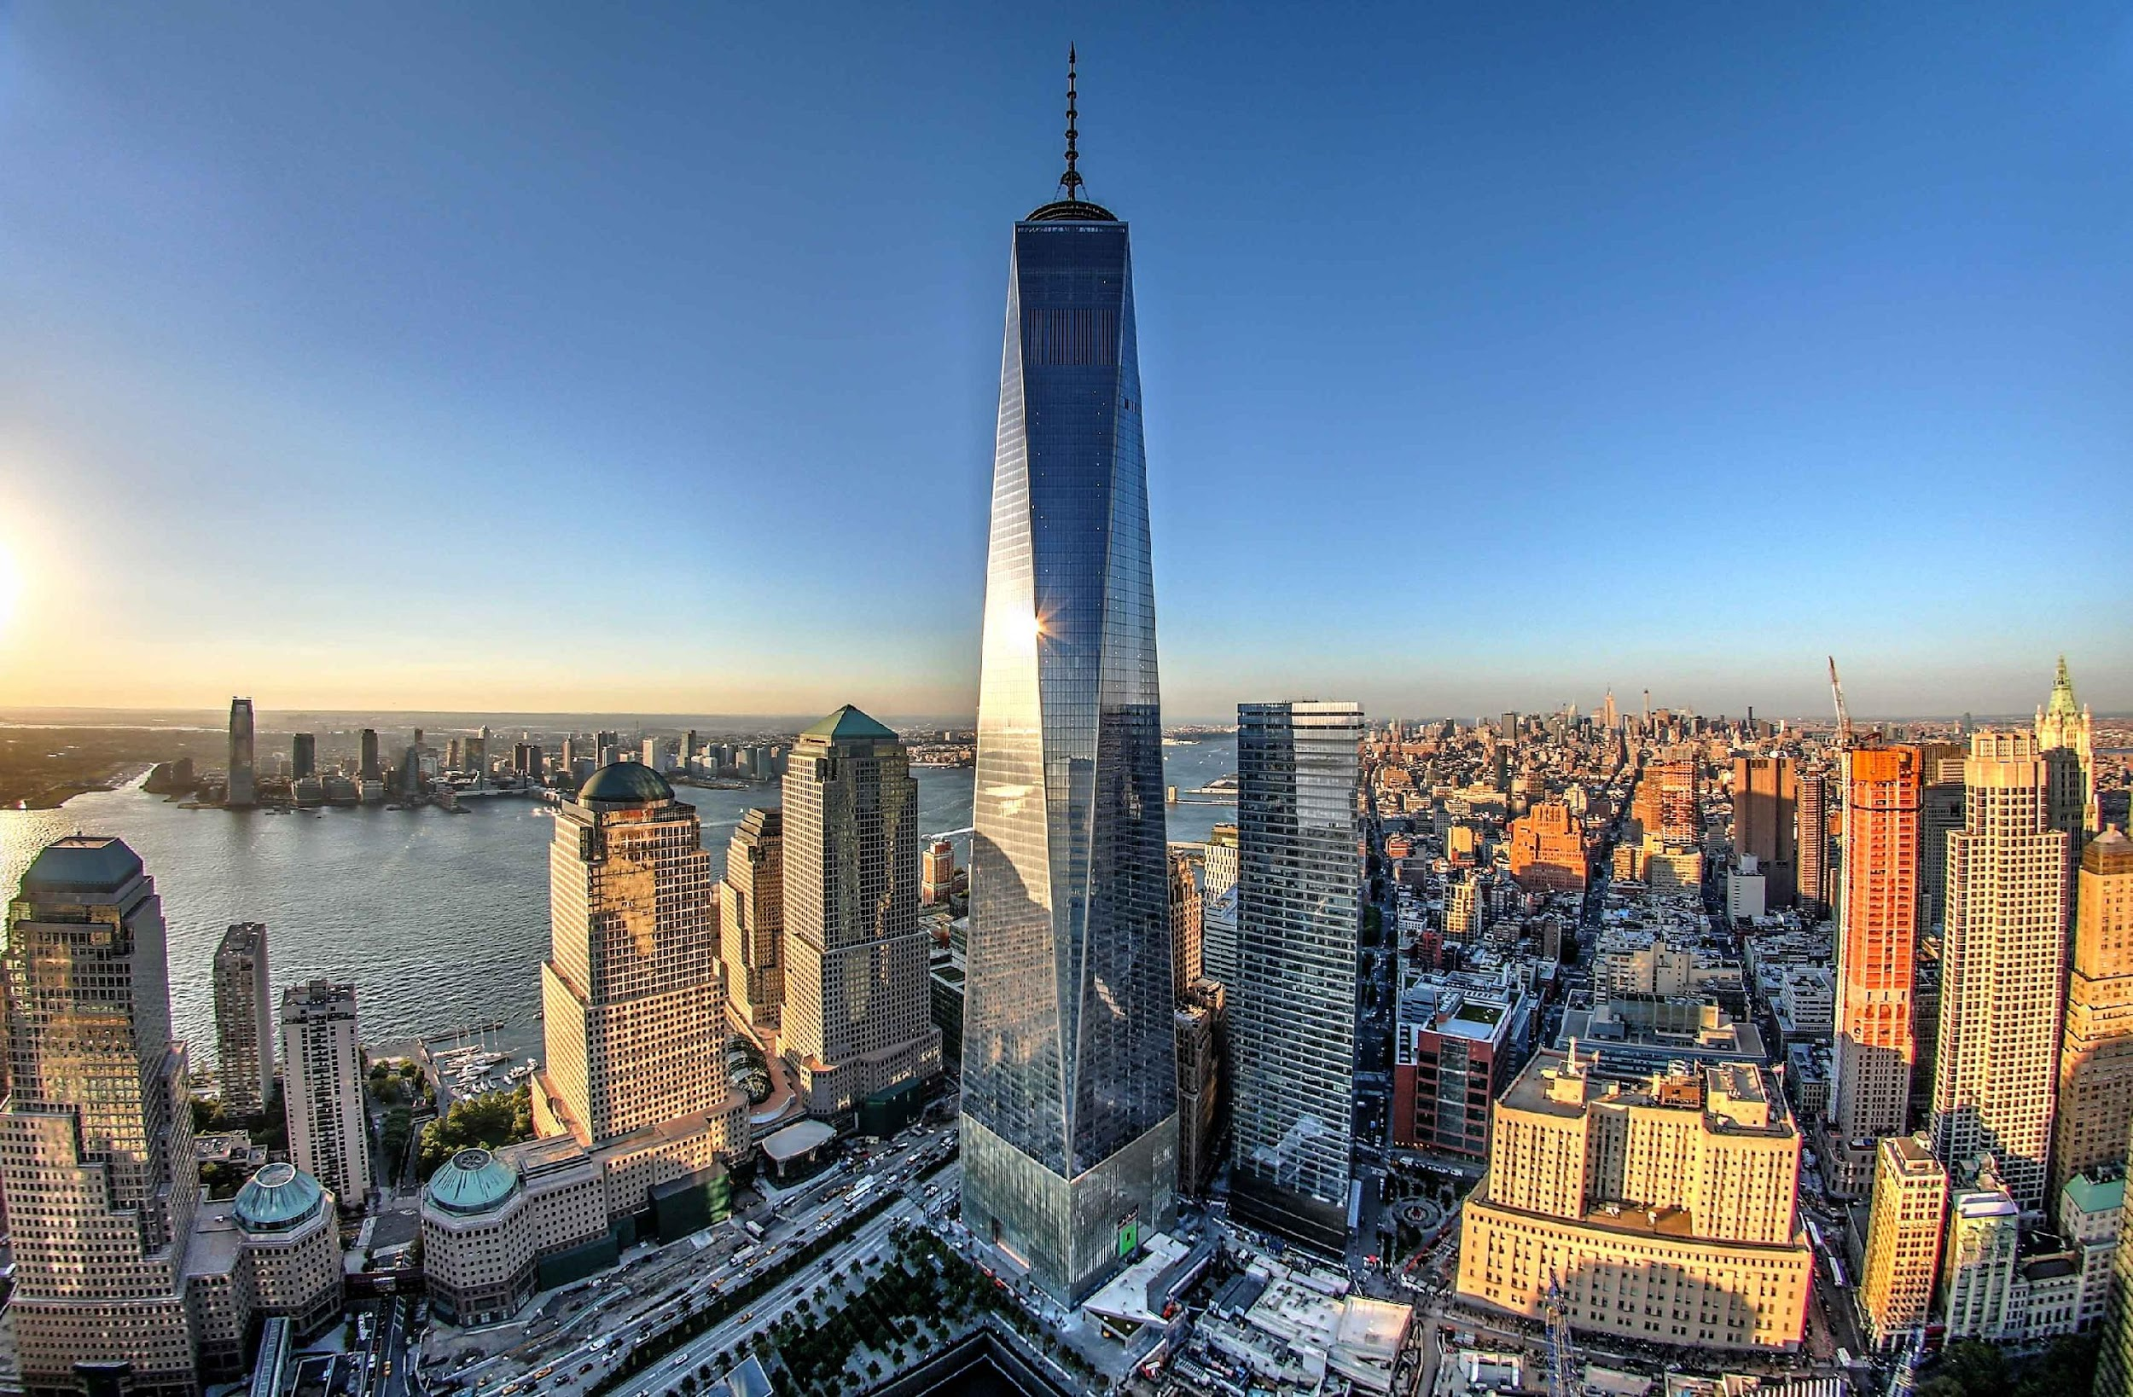
ONE WORLD TRADE CENTER

Slide 16
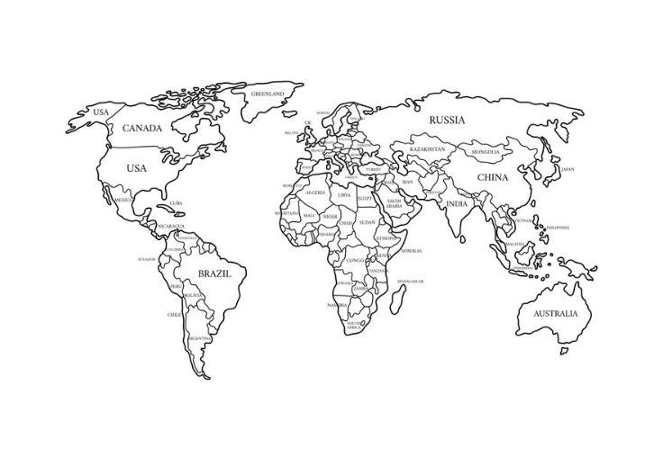
COUNTRIES SERVED
100+ countries
Over 15,000 machines shipped around the world

Slide 17
OUR GOAL?
Supply everything a fabricator needs
Blaster
Automated Welder
Drill
Plate Machine
Saw

Slide 18
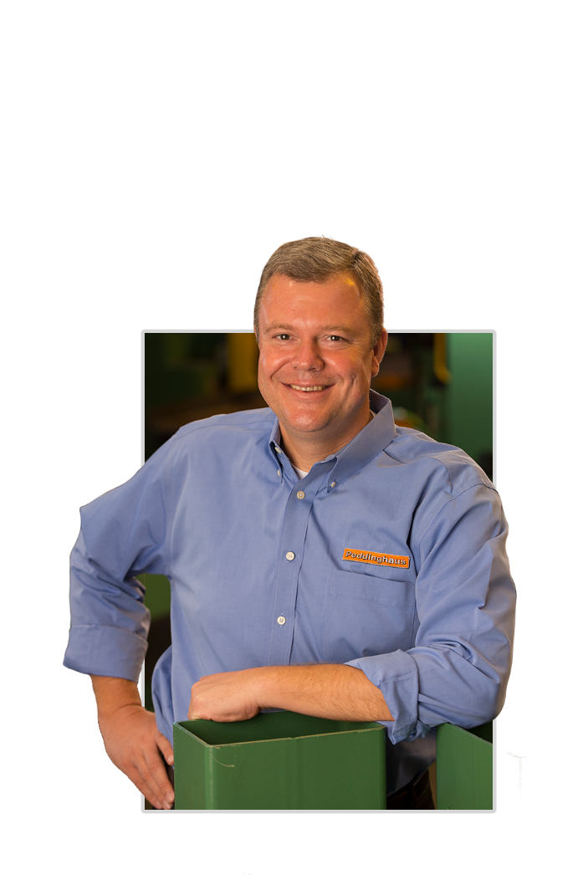
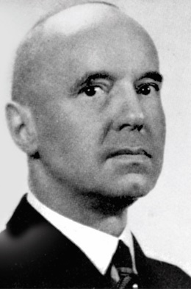
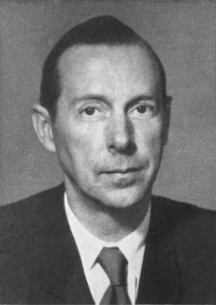
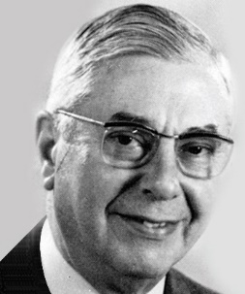
5TH GENERATION COMPANY
Founded in 1903 in Gavelsburg, Germany
Started U.S. Operations in 1977
1997 – started Operation in South Caroline
2004 – Headquarters moved to Bradley, Illinois

Slide 19
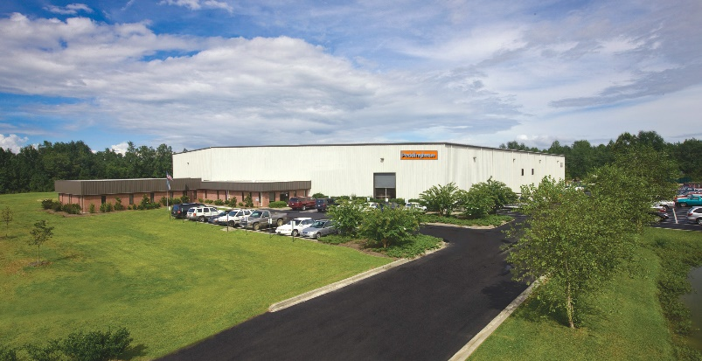
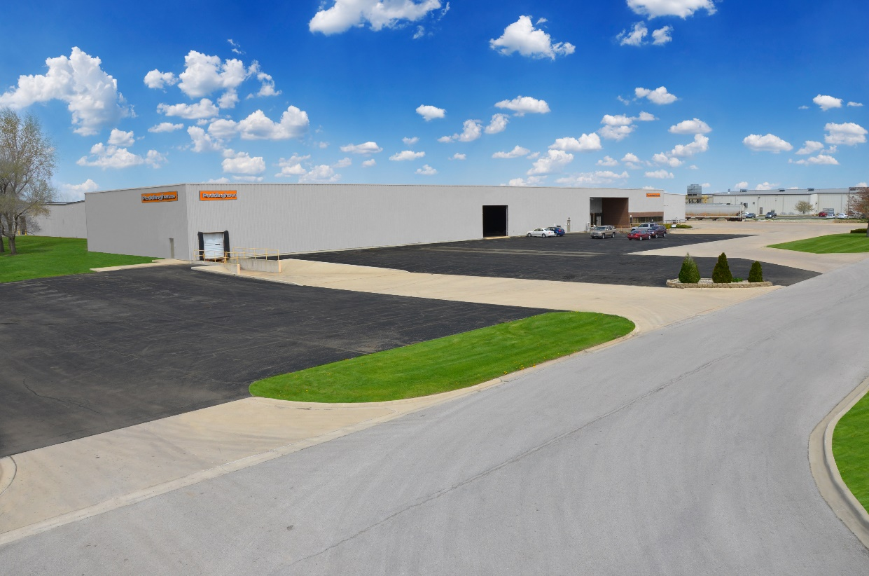
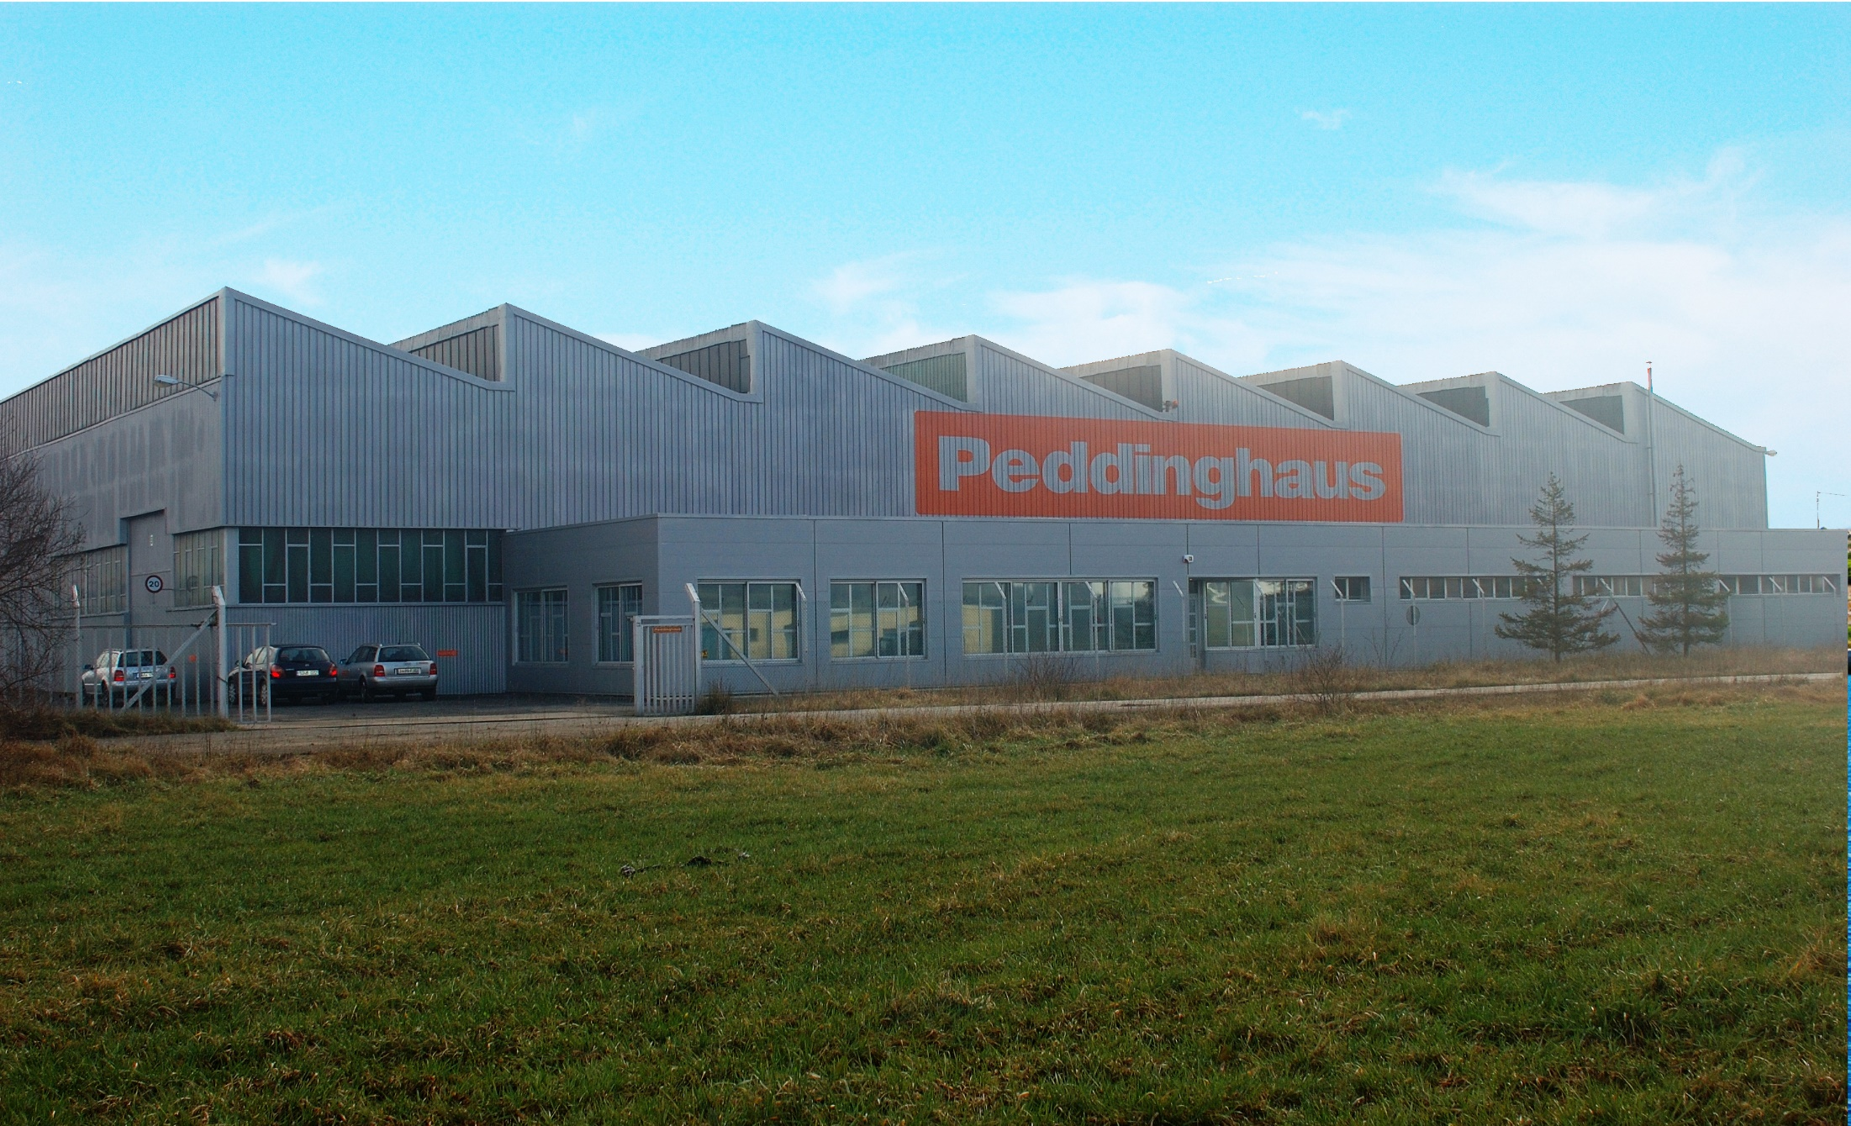
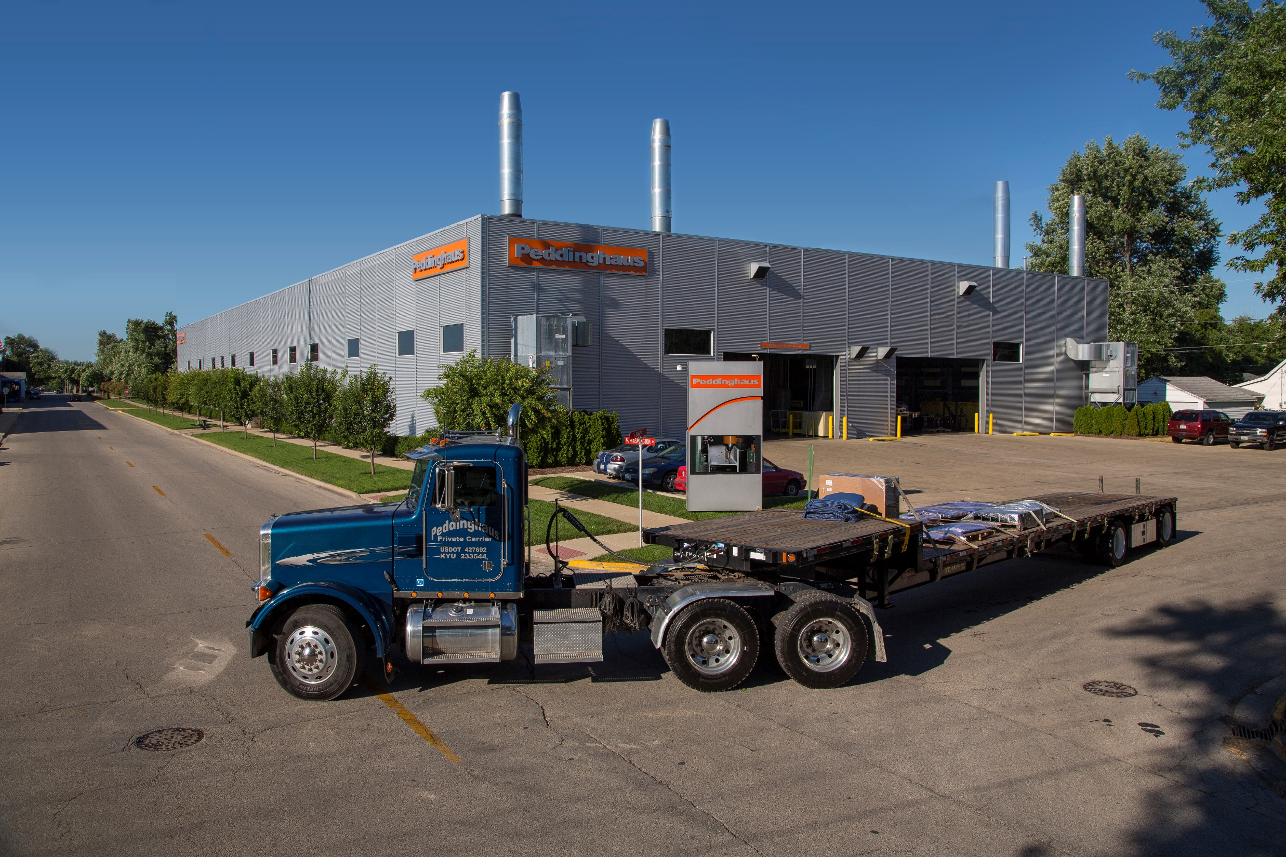
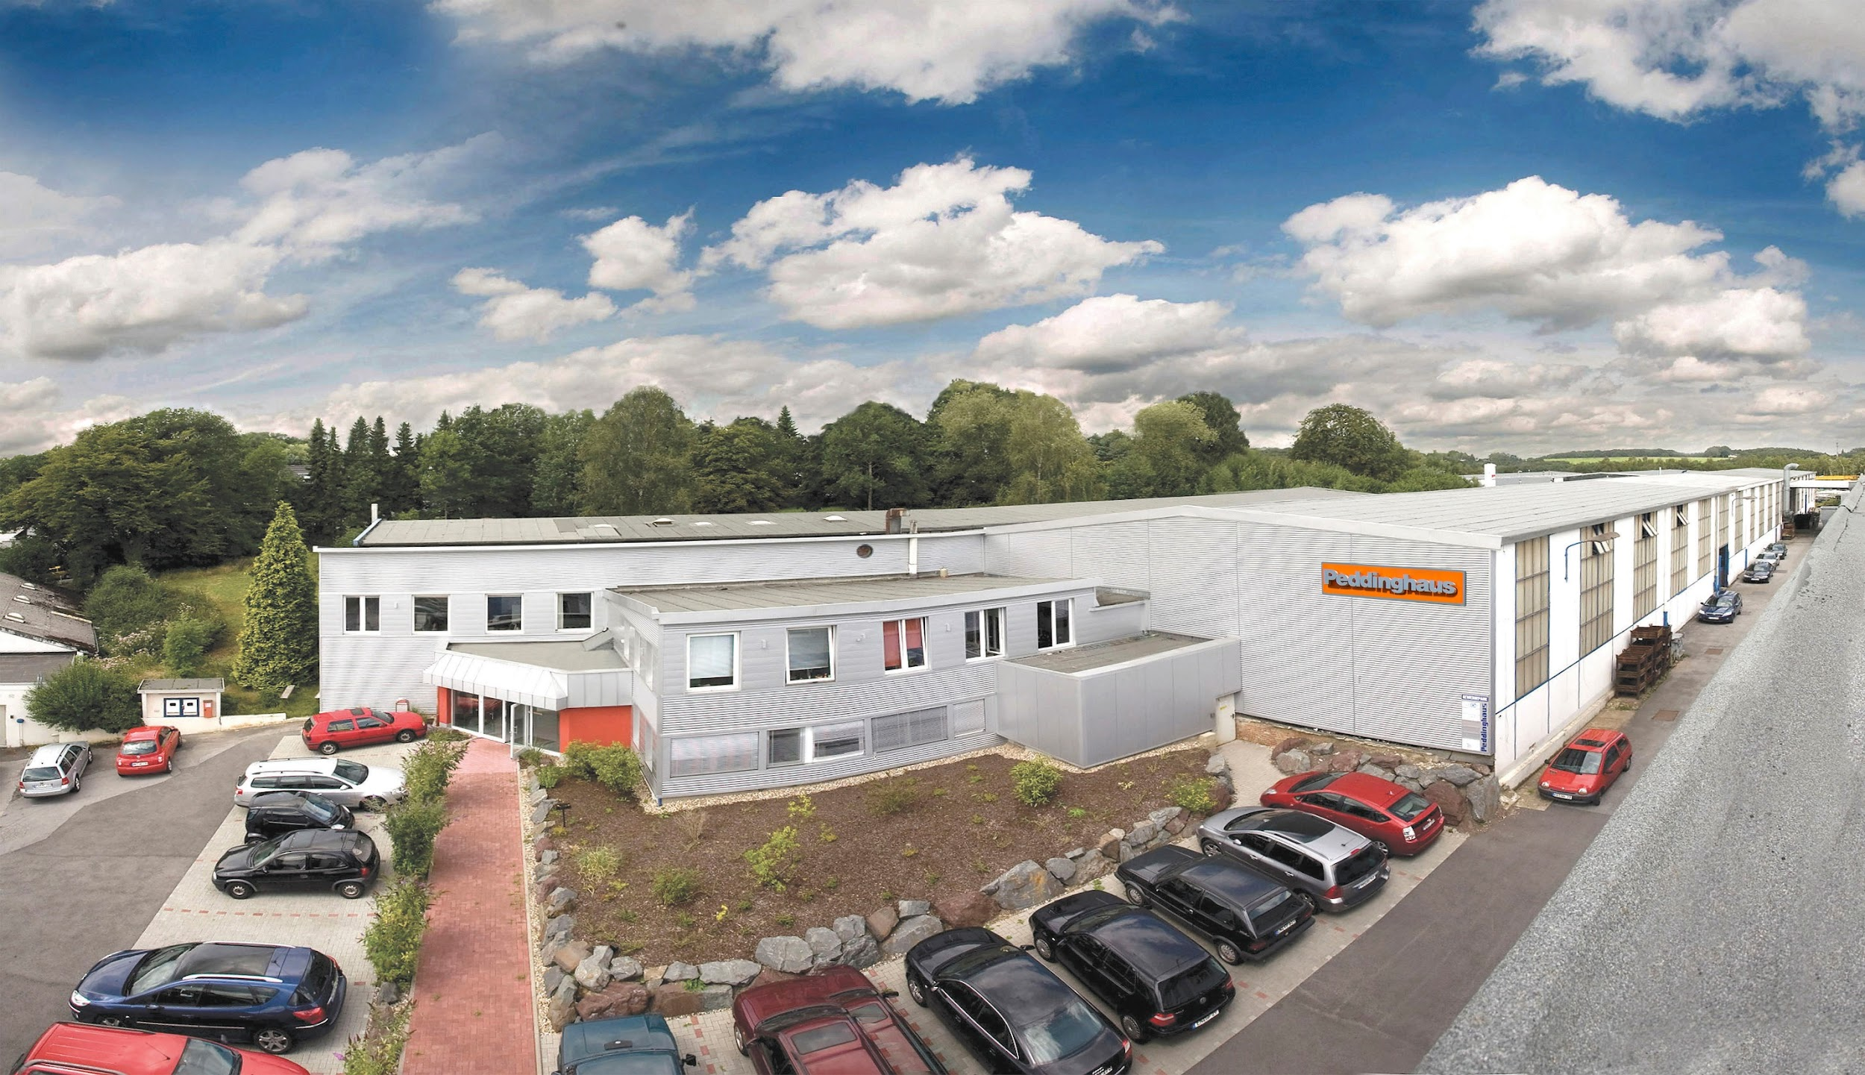
9 GLOBAL LOCATIONS
Bradley, Illinois
Kankakee, Illinois
Andrews, South Carolina
Gavelsburg, Germany
Victoria, Spain
Shanghai, China
Birmingham, United Kingdom
Monterrey, Mexico
Johannesburg, South Africa

Slide 20
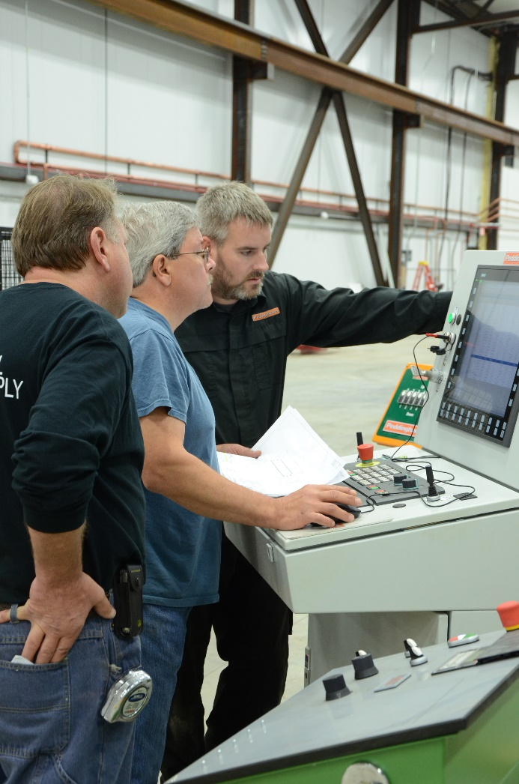
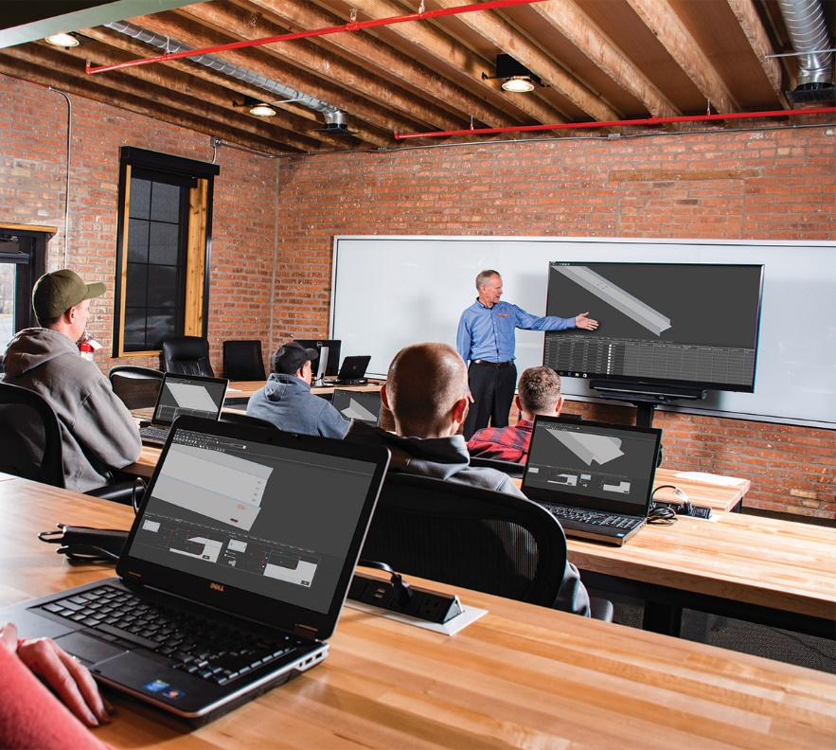
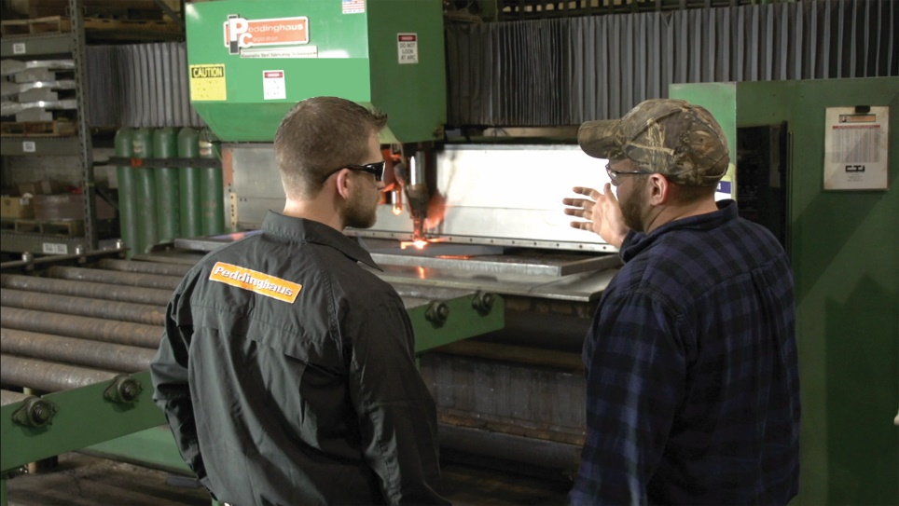
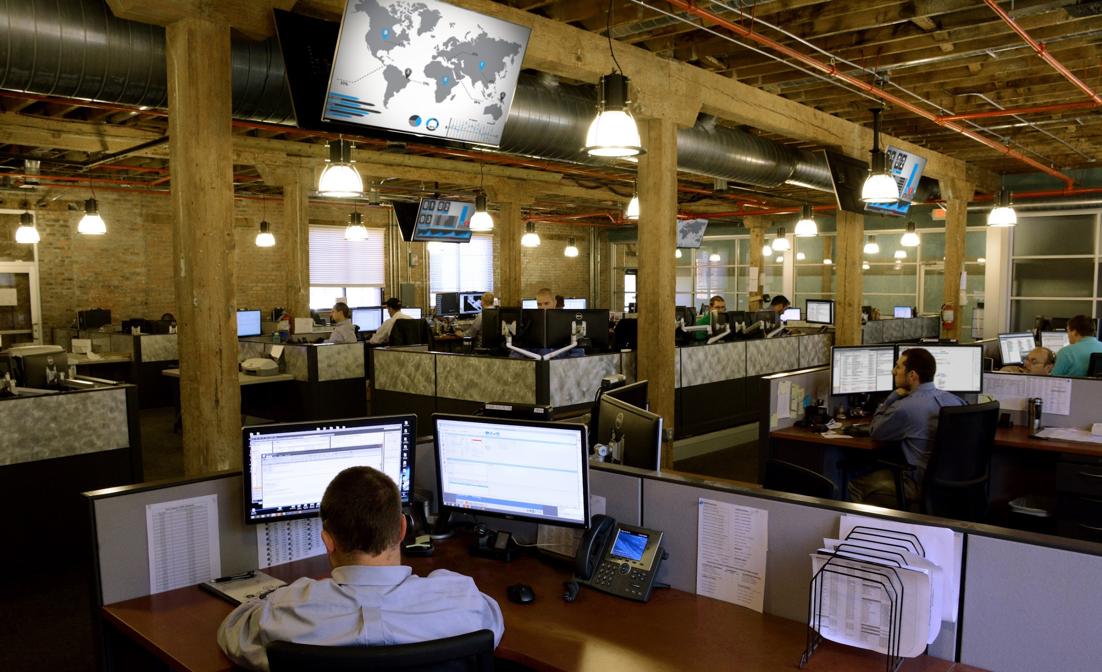
WHAT WE OFFER
24 Hour Customer Support
$25,000,000 in spare parts here in Bradley, Illinois
Over 80 Field Service Techs
World Class Training Facility
All components on the machines are produced in house

Slide 21
ANY QUESTIONS?

